Slide 1
Psychology Meme Project

Slide 2
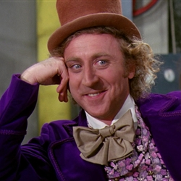
What is a meme?
A meme is like a knock knock joke. These famous memes are the basis for your own joke.

Slide 3
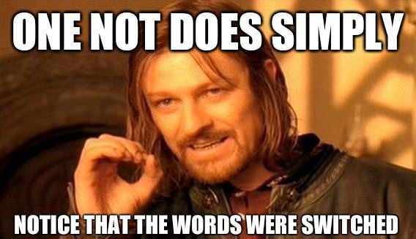
Go to memegenerator.net
Take this famous meme: Click on generate
Generate your own caption.

Slide 4
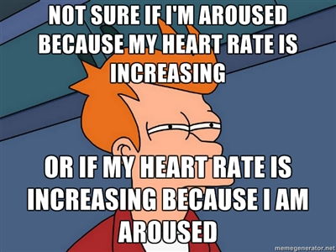
Here’s another:

Slide 5
It’s also okay to use your own photo and create your own.

Slide 6
Requirements
Create at LEAST one meme that you will print and hand in today.
Save your meme as a jpeg and email it to me.
The ‘other’ AP classes will vote on their favorite meme from this class; winners will be rewarded!
Extra credit: Use your meme as a starting point for discussions on social media. You will have to ‘prove it’ for extra credit.

